Slide 1
Analgesics, Antipyretics and Anti-inflammatory Agents
IP5A1: Understanding Inflammation and pain
Dr Ken Wojcikowski

Slide 2
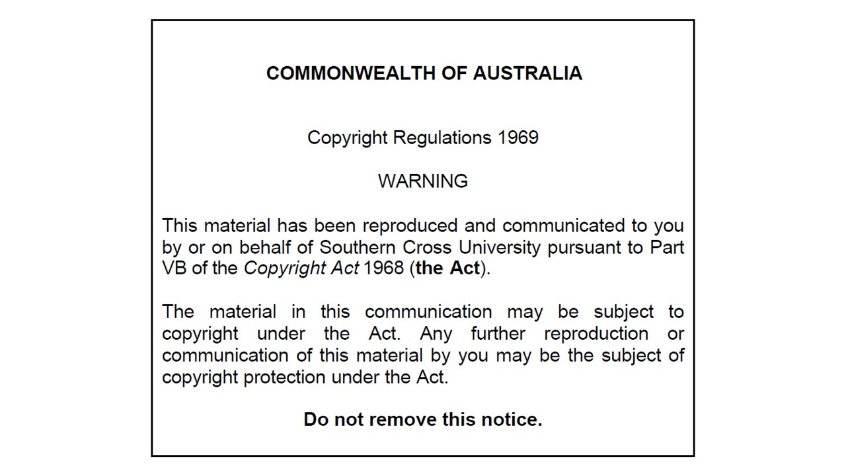

Slide 3
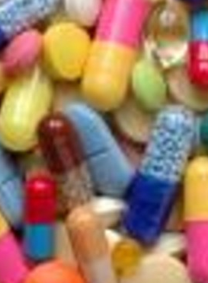
Analgesics, Antipyretics and Anti-inflammatory Agents
IP5A1: Understanding Inflammation and pain
Ken Wojcikowski, PhD (Pharmacology and Toxicology; School of Medicine, University of Queensland)

Slide 4
Specific objectives for Part 1
Define the term ‘pain’ and briefly discuss the most important points about pain from a clinical aspect.
Briefly describe inflammation, placing the most common anti-inflammatory agents into the context of that description.
Describe the role of prostaglandins and cytokines in the process of inflammation and fever, and cite examples of their actions. Relate this to the anti-inflammatory agents that affect these mediators of inflammation.
Briefly describe the pain pathway, overviewing the way in which our analgesics work.
Describe the gate control theory of pain, and the way in which our understanding of pain has evolved.

Slide 5
Definition of pain; types of pain; importance of treating pain
Dr Ken Wojcikowski

Slide 6
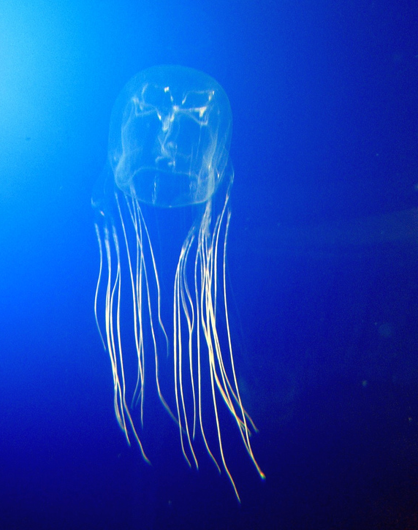
What is pain?
International Association for the study of pain:
  “Pain is an unpleasant sensory and emotional experience, associated with actual or potential tissue damage, or described in terms of such damage.”
        Chironex sp. (box jellyfish)
"small box jellyfish (Chironex fleckeri, possibly yamaguchii)" by gautsch. is licensed under CC BY-SA 2.0.

Slide 7
What is pain?
Pain is an emotion and a sensation.
  Protective mechanism
  Detects, localises and identifies tissue damaging processors.
Pain varies between individuals.
  Subjective experience that varies in individuals
    Physical
    Psychological (anxiety, memory)
    Environmental factors
Pain varies between individuals and situation e.g. during a battle or childbirth.
Pain is affected by mental state, anxiety, expectation of pain, past experiences and many other factors
Notes:
7

Slide 8
Types of pain
Acute Pain:
  Tissue damage
  Inflammatory cascade
Sub-acute phase:
  Transition from acute to chronic pain
  4 month window (aggressive treatment indicated now)
  Neuroplastic changes to CNS
Chronic pain:
  CNS becomes sensitized
  Responds excessively to stimuli
    Debilitating, expensive & effects everyone surrounding patient
    Chronic pain begins to have similarities with neuropathic pain

Slide 9
Acute verses chronic pain
Chronic pain decreases level of endogenous opioids in the spinal cord
Changes in dorsal root ganglion include inflammation that increases transmission of impulses.
Chronic pain often results in loss of appetite, sleep disturbances and depression
Substance P is a neurotransmitter that lasts MUCH longer than ideal

Slide 10
Treatment aims for pain
  Decrease pain and suffering/reduce morbidity
  Improve physical and mental function
  Provide hope and emotional wellbeing
  Help patients reach a point of acceptance with their status
  …with the smallest dose (least amount of damage)

Slide 11
Mechanisms of inflammation and anti-inflammatory agents
Dr Ken Wojcikowski

Slide 12
Definition of inflammation
(Merriam Webster)
A local response to cellular injury that is marked by:
capillary dilatation,
leukocytic infiltration,
redness,
heat, and
pain
(Serves as a mechanism initiating the elimination of noxious agents and of damaged tissue).

Slide 13
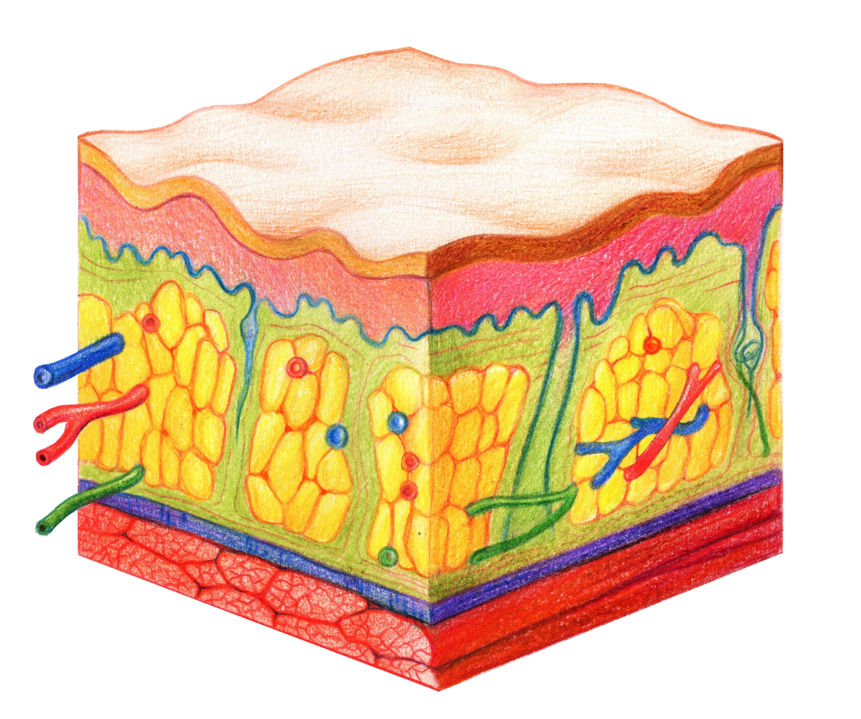
Inflammation occurs in the interstitial spaces.
(Between the cells visible in this diagram)
Shutterstock image

Slide 14
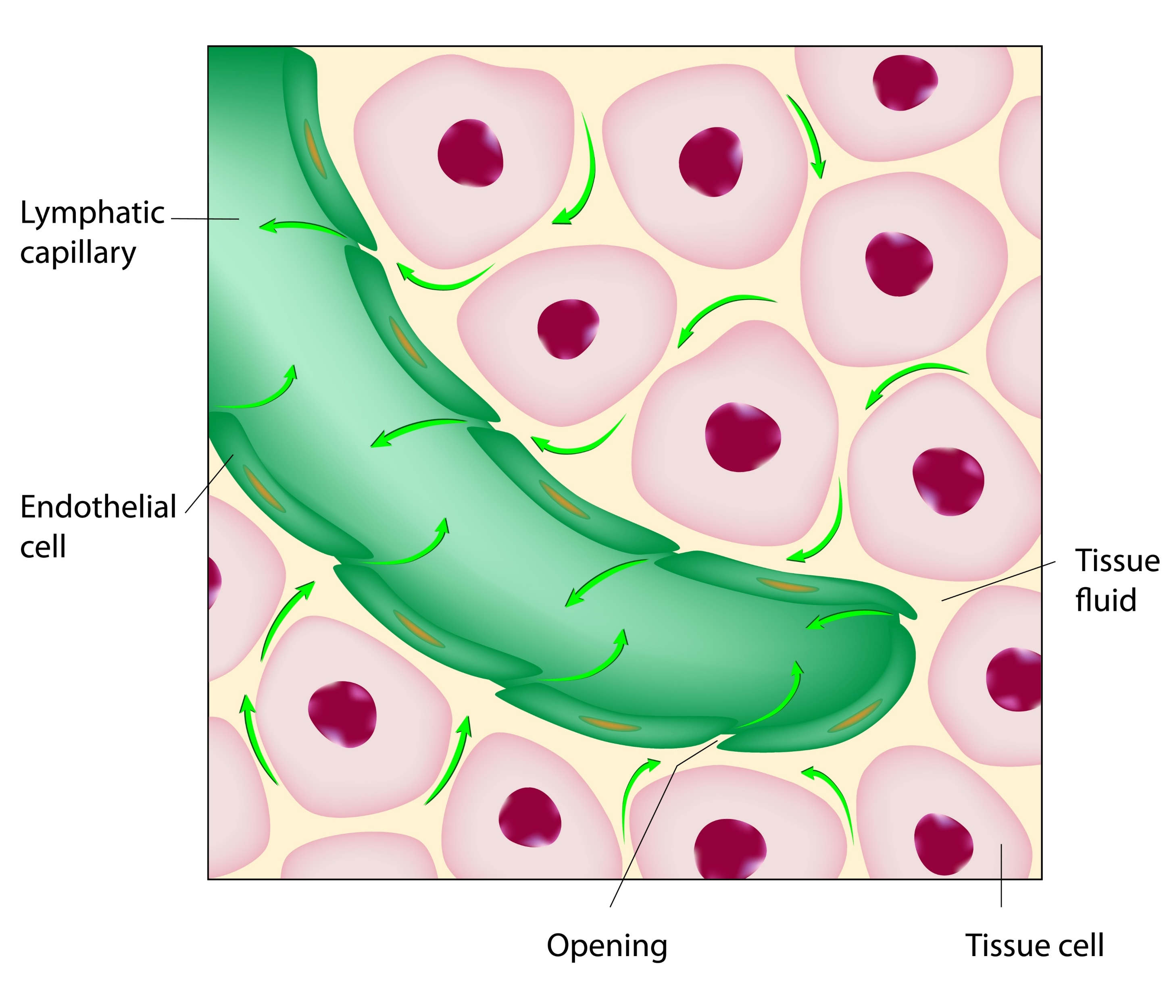
One of the aims of inflammation is to remove the offending microorganism, debris and dead cells and to carry it off into the lymphatic vessels.
This happens in the area between the cells of the organ involved
Shutterstock image

Slide 15
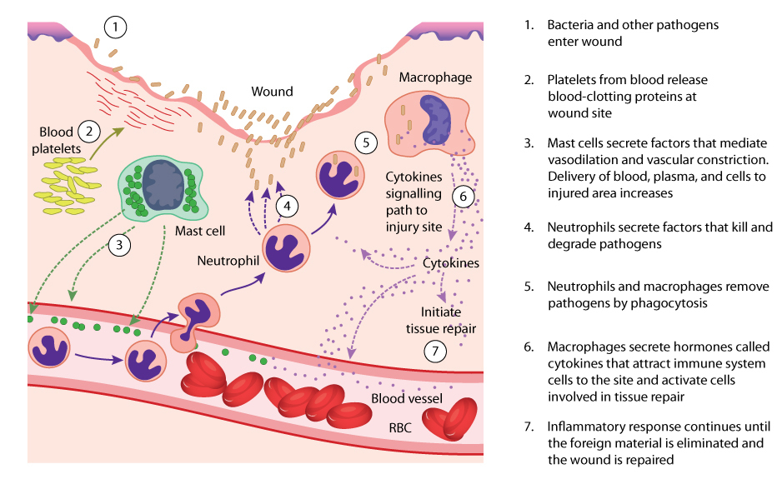
Shutterstock Image

Slide 16
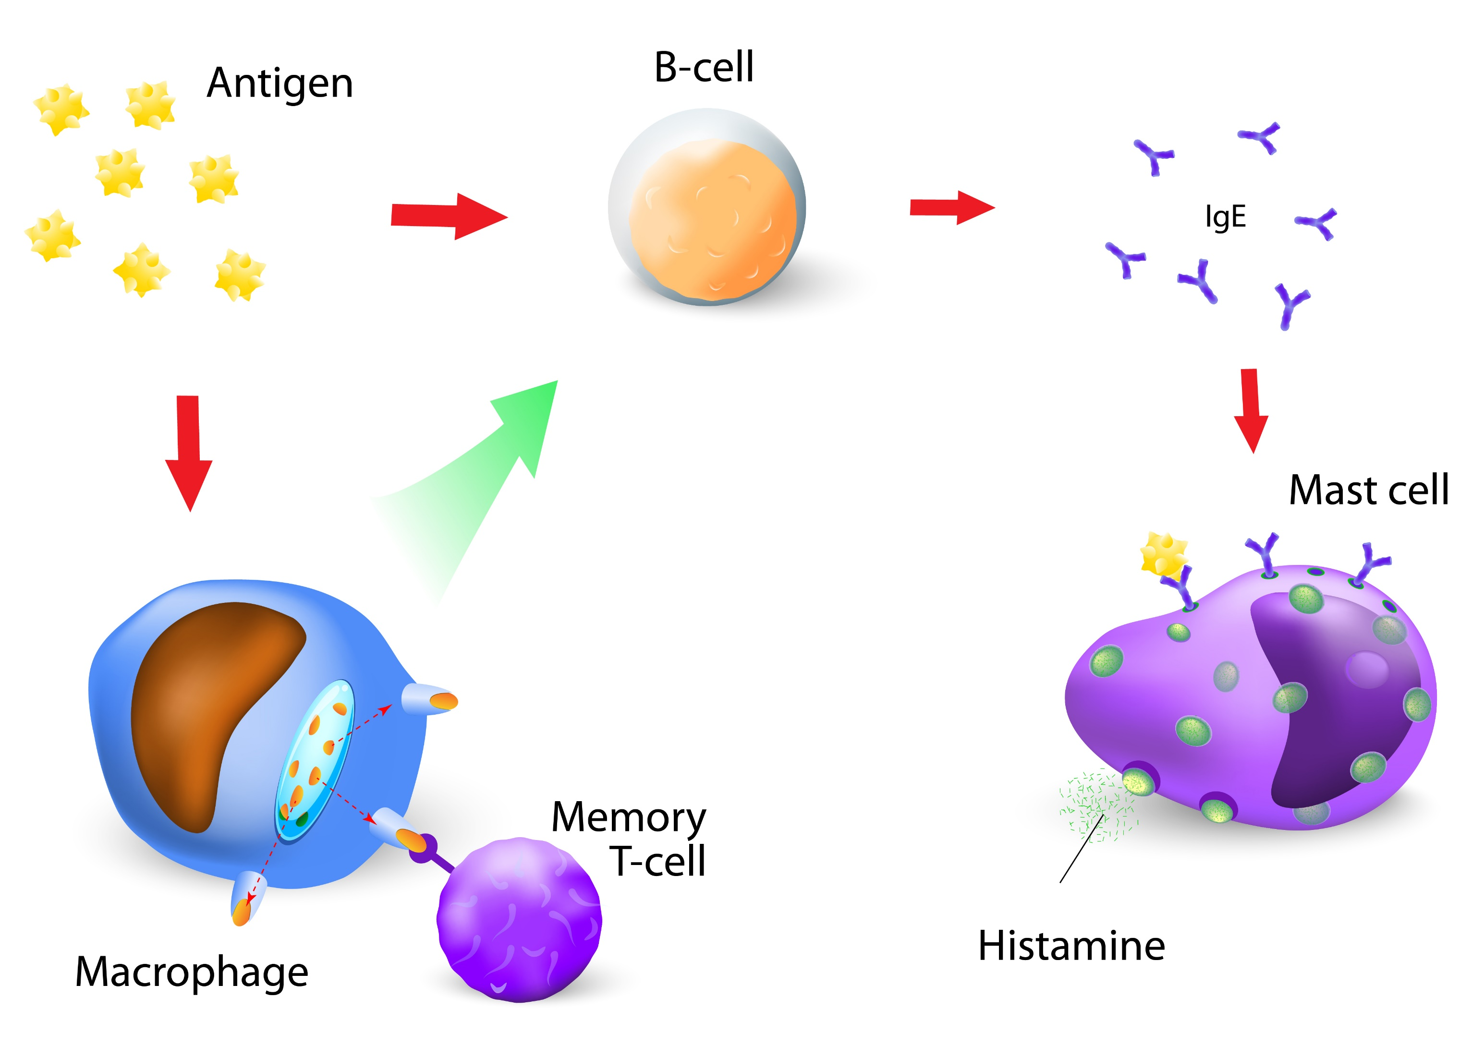
“Steroidal anti-inflammatory agents” are the glucocorticoids like prednisone.
Those agents decrease ALL ‘arms’ of the immune system.
B cells, T cells, mast cells, macrophages, and all mediators of inflammation are decreased with steroidal anti-inflammatory agents.
See next slide for actions
INFLAMMATION
Prostaglandins
Shutterstock image

Slide 17
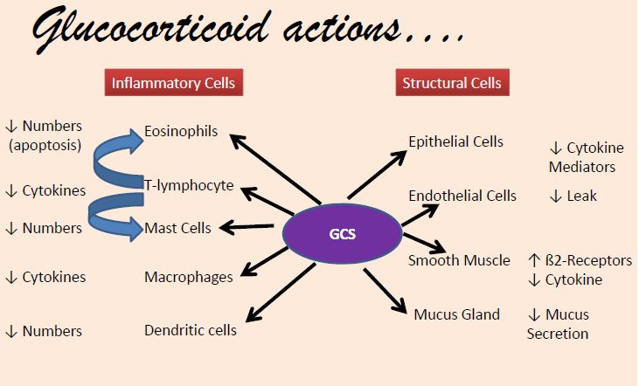
https://www.intechopen.com/chapters/41142

Slide 18
Other anti-inflammatory agents
Other anti-inflammatory drugs target specific aspects of inflammation.
Cyclooxygenase inhibitors
NSAIDS and COX 2 inhibitors target the enzyme that makes prostaglandins.
NSAIDs (non-steroidal anti-inflammatory drugs that do not act like cortisol and the glucocorticoid steroids).
COX 2 inhibitors (inhibit cyclooxygenase 2)

Slide 19
Other anti-inflammatory agents
Some anti-inflammatory agents inhibit the actions of immune cells or block the receptors for inflammatory mediators.
Mast cell inhibitors, example:
Leukotriene receptor antagonists.
Tumour necrosis factor antagonists

Slide 20
Other anti-inflammatory agents
Agents that have some anti-inflammatory effects
but are not considered anti-inflammatory drugs
Antihistamines (block the histamine receptor)
Sympathomimetics (stabilize mast cells)

Slide 21
Mechanisms of pain and analgesics
Dr Ken Wojcikowski

Slide 22
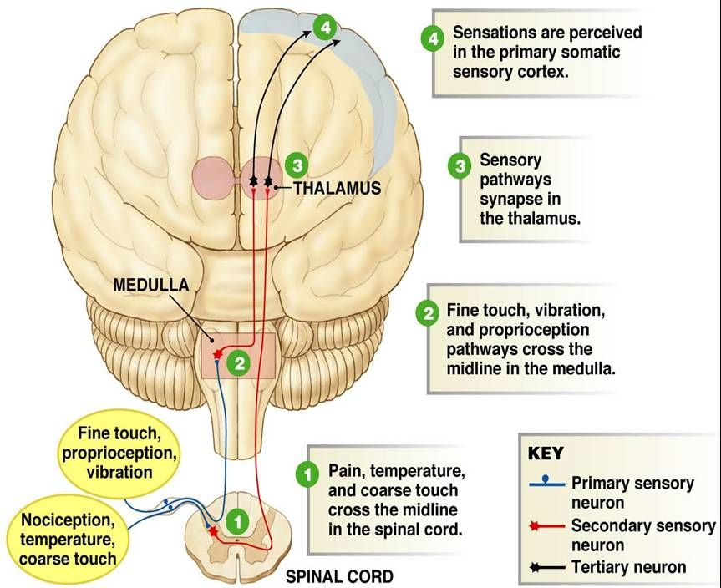
Overview
The pain pathway consists of three ‘orders of neurons’
Depicted here as:
Primary
Secondary
Tertiary
Shutterstock image

Slide 23
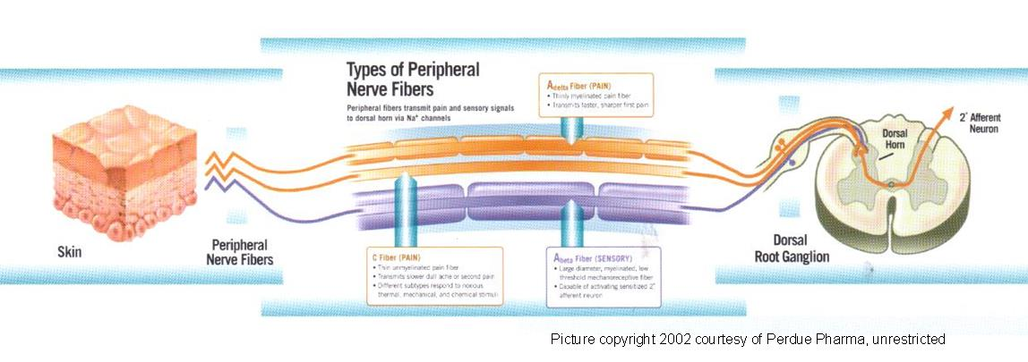
First order of neurons: the message begins in the periphery, and travels into the spinal cord

Slide 24
Pain pathways
A delta fibres
  Large/myelinated
  Rapid sharp localised pain
  Drop off information primarily in the Thalamus
C fibres
  Slower/non myelinated
  Dull, aching poorly localised pain
  Drop off information primarily in the Brain Stem
  Chronic pain is primarily through this path
Notes:
24

Slide 25
Modifying the pain
Stimulation of large, heavily myelinated A beta fibres (which synapse in the same place as A delta fibres) can reduce the pain. These carry mechanical info
  Thus sucking on the thumb you just crushed or “licking your wounds” decreases pain
Intensification of pain can occur with higher brain control
  (fear of the injection)

Slide 26
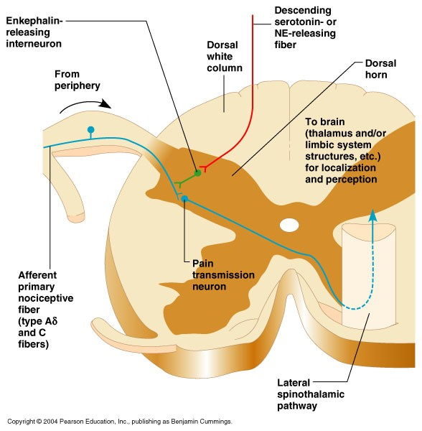
The ‘gate’ in the spinal cord

Slide 27
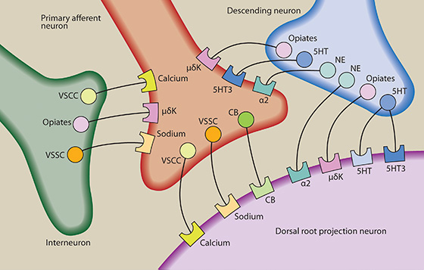
The second ‘order of neurons’
Legend:
5HT/5HT3:Serotonin
CB: cannabinoids
CBZ: carbamazepine
LMT: Lamotrigine
NE: Norepinephrine
SNRI: selective norepinephrine reuptake inhibitor
TCA: tricyclic antidepressant
VSCC: voltage sensitive calcium channel
VSSC: voltage sensitive sodium channel
Shutterstock image

Slide 28
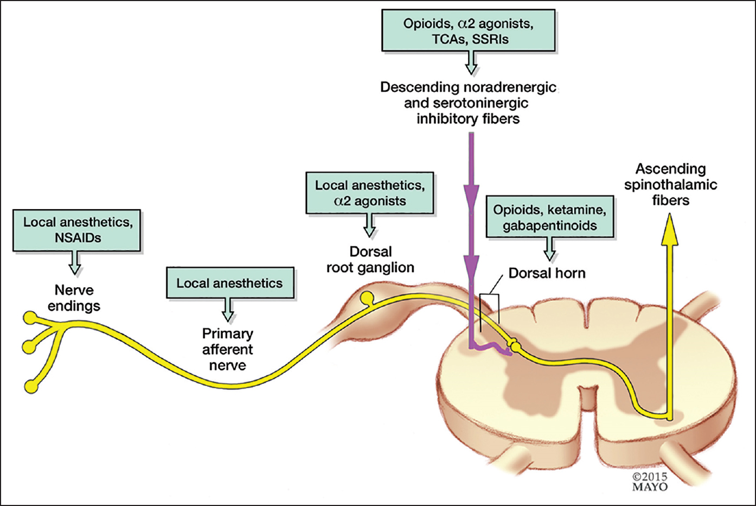
Analgesics:
Location of action
(Mayo Foundation for Medical Education and Research, 2015)

Slide 29
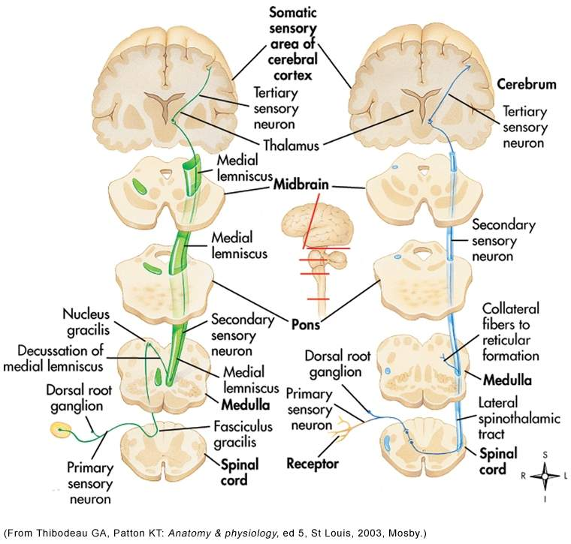
Spinothalamic tract carries A and C fibres
The first order of neurons (primary sensory neuron) only goes to the spinal cord before synapsing.
At the synapse, there are enkephalin (opioid) releasing interneurons from that are controlled by the brain.

Slide 30
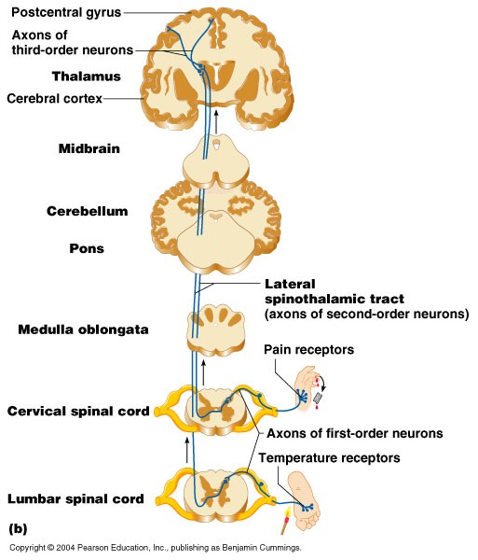
The second order of neurons travels up the contralateral side, to the thalamus AND BRAINSTEM.
The third order of neurons carries the information to the primary sensory areas of the brain and areas of the limbic system

Slide 31
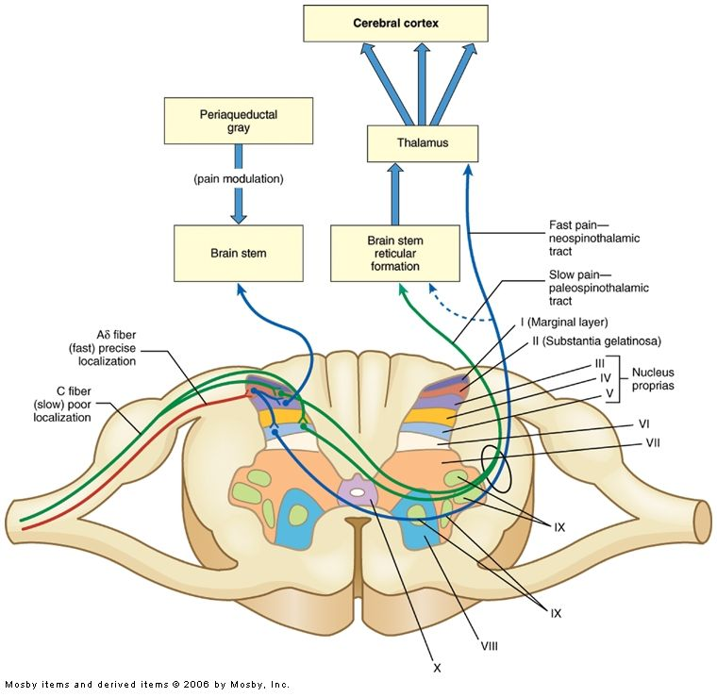
"Foundations of Anesthesia", second edition, 2006 Elsevier Mosby

Slide 32
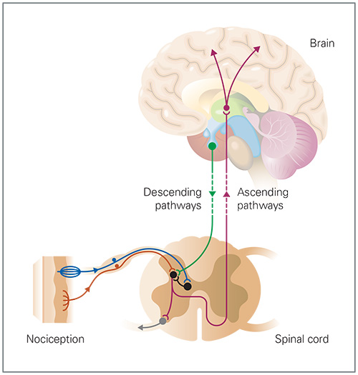
Shutterstock Image

Slide 33
Mechanisms of pain
Limbic and reticular tracts are involved in alerting body to danger
  Both regulate the emotional responses to pain
  Arouse the whole organism to the possibility of damage
  Autonomic reflexes
  Neuroendocrine responses

Slide 34
Analgesics, Antipyretics and Anti-inflammatory Agents
Part 2: NSAIDs, antipyretics, and over the counter analgesics
Ken Wojcikowski, PhD (Pharmacology and Toxicology; School of Medicine, University of Queensland)

Slide 35
Analgesics, Antipyretics and Anti-inflammatory Agents
Part A2: NSAIDs, antipyretics, and over the counter analgesics
Dr Ken Wojcikowski

Slide 36
Specific objectives for Part 2
State the definition of NSAIDS and mechanisms by which NSAIDs work to reduce pain
Briefly describe fever with respect to the way in which it develops, and how our antipyretic agents work to reduce fever.
Name at least 7 benefits of fever.
Using ibuprofen, aspirin and naproxen as examples of NSAIDs, state the indications contraindications and side effects (including long-term side effects) of NSAIDs.
State the indications contraindications and side effects (including long-term side effects and toxic effects) of paracetamol.

Slide 37
Fever:
Mechanisms by which it develops
The value of fever as a defence
Dr Ken Wojcikowski

Slide 38
Shutterstock Image

Slide 39
Fever
A normal adaptive response to endogenous or exogenous pyrogens
A trigger of the fever, called a pyrogen, crosses the BBB and causes a release of prostaglandin E2 (PGE2) at the hypothalamus. PGE2 then in turn acts on the hypothalamus, which generates a systemic response back to the rest of the body, causing heat-creating effects to match a new temperature level.
Exogenous pyrogens
  lipopolysaccharide complex in the cell wall of gram-positive bacteria (mediated by secondary inflammatory molecules)
Endogenous pyrogens
  Inflammatory cytokines (Interleukin 1 and 6, tumour necrosis factor and interferon gamma) break into the BBB, signalling the release of prostaglandin E2 which acts on the hypothalamus

Slide 40
Antipyretics
Before giving antipyretics, please be aware of the benefits of fever:
Increased temperature kills many micro-organisms
Increased temperature has adverse effects on the growth and replication of others
Higher body temperatures decrease serum levels of iron, zinc and copper needed for bacterial replication
Increased temperature prevents viral replication in infected cells
Fever is one of the inflammatory factors that promotes liver to produce acute-phase proteins
Heat binds cations necessary for bacterial reproduction
Heat increases lymphocytic transformation
Heat increases motility of polymorphonuclear neutrophils
Phagocytosis is enhanced during fever
Production of antiviral interferon may be augmented during fever

Slide 41
Medications with antipyretic actions
All NSAIDs (Ibuprofen, Naproxen, others)
Aspirin
Paracetamol
Corticosteroids

Slide 42
NSAIDs and COX2 inhibitors
Dr Ken Wojcikowski

Slide 43
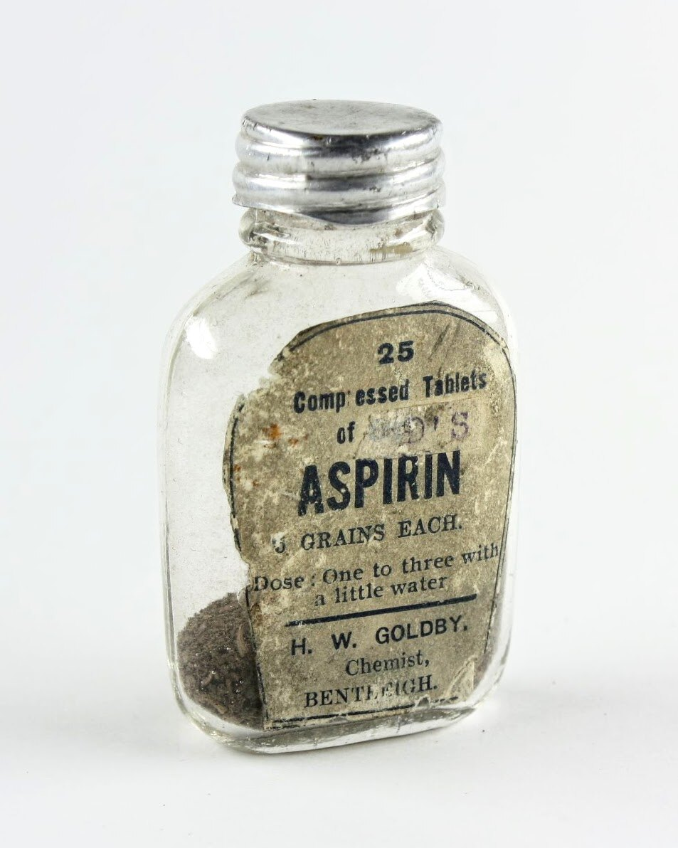
NSAIDs / Aspirin
Mechanism of action
  Inhibit Prostaglandin formation
    Inactivation of COX, the enzyme that forms prostaglandins
    Analgesic
    Anti-inflammatory
    Antipyretic
    E.g. Ibuprofen, Naproxen, indomethacin
    Aspirin specific points are discussed in
    the Cardiovascular portion of this unit
Copyright Museums Victoria / CC BY (Licensed as Attribution 4.0 International)
Notes:
43

Slide 44
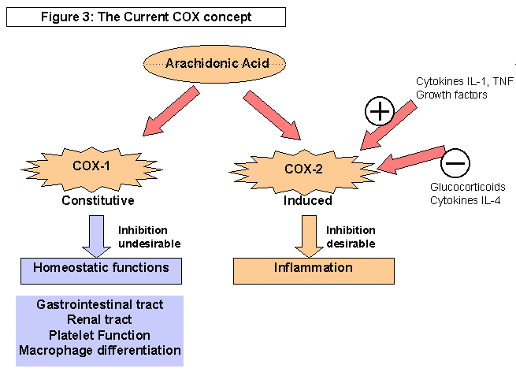
From: http://darkwing.uoregon.edu/~jlong/fa00/199/aspirin.html

Slide 45
Prostaglandin antagonists
Examples of prostaglandin antagonists are:
NSAIDs (inhibit cyclooxygenase)
Corticosteroids (inhibit phospholipase A2 production)
COX-2 selective inhibitors of cyclooxygenase 2 (…coxib drugs)

Slide 46
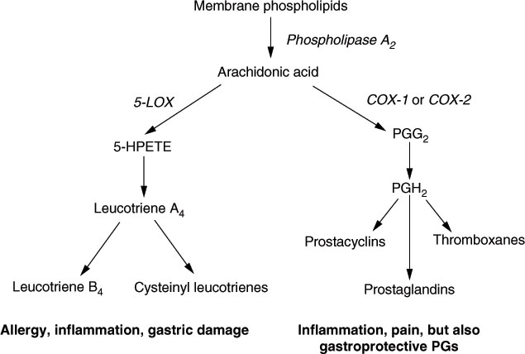
Mediators of inflammation: Prostaglandins and Leukotrienes
Notes:
46

Slide 47
NSAIDs : side effects
  COX1: impaired gastric and renal protection
    Use a PPI
  CARE:
    Asthma. (patient-specific: may increase risk of bronchospasm)
    History of GI bleeding
    Heart failure, hypertension
      Na and Fluid retention
    Renal or hepatic impairment
      Alcoholic liver disease
    Cardiovascular risk

Slide 48
NSAIDs: Warning signs / Risk Factors
Black stools, Coffee ground vomit (these are from GIT bleeding)
Age: 65+ (as discussed later)
History of ulcers
Long course
Nephrotoxic drugs or anticoagulants
  (NSAIDs are contraindicated with Warfarin and may increase nephrotoxicity of other drugs)
Difficulty breathing
Use lowest dose for shortest time.
Using a PPI at the same time may decrease the risk of ulcers

Slide 49
COX 2 Inhibitors (…coxib suffix)
Celecoxib, Parecoxib
Data from early studies was manipulated
These are no more effective than NSAID’s and have serious risks associated with long term use.
Short term use only.
Notes:
49

Slide 50
COX 2 Inhibitors
Celecoxib, Parecoxib
No more effective than NSAID’s; use if:
  unresponsive to NSAID’s
  or risk of GI ulceration
Adverse effects:
  headache, diarrhoea, abdominal discomfort, acute renal failure & dizziness
Increased risk of thrombotic events
  Increased risk of MI/Stroke in studies
Notes:
50

Slide 51
Paracetamol (Acetaminophen)
Dr Ken Wojcikowski

Slide 52
Paracetamol
Said to be the first line treatment for mild-moderate pain (this has been contested in meta analyses determining that it has very little analgesic effect)
500mg tablets/ 665mg SR, IV
Wide usage
Rapidly absorbed
Extensive first pass metabolism
Short half life……1-4 hours (VERY VARIABLE!)
Notes:
52

Slide 53
Paracetamol
NO known and confirmed mechanism of action:
  Seems to be converted to the active metabolite in the brain.
  Little or no effect on peripheral prostaglandin synthesis
  Unsuitable for reducing inflammation e.g. RA

Slide 54
Paracetamol toxicity
Paracetamol toxicity is the number one cause of liver failure in Australia, UK, USA, NZ and Canada.
Toxicity - At risk if:
  Doses > 4g / day
  Person metabolizes less quickly (variable half life of 1-4 hours)
  Client is after the opioid high: Taking combinations of opioids and paracetamol
  Paracetamol is often used for suicide attempts: education is necessary! The more you take, the more TOXIC IT IS. High doses do not increase efficacy!
Notes:
54

Slide 55
Please reflect on the previous slide
Paracetamol is said to be ‘safe’ , but it is the #1 cause of liver failure in Australia
28% of cases of liver failure are unintentional
Paracetamol only has 1/140th the analgesic effect of morphine and it cannot get more potent with larger doses

Slide 56
Paracetamol overdose
Toxicity if concentration >150mcg/ml/
Liver toxicity, hypoglycaemia & acute renal tubular necrosis
May take several days: this is a very painful way to die
Give N-acetylcysteine
  Guidelines
Notes:
56

Slide 57
Pain relief in children and the elderly
Dr Ken Wojcikowski

Slide 58

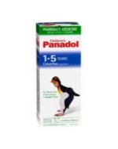
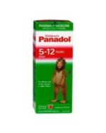
Pain relief in children
Difficult to evaluate
Under treated & under managed
Difficult to separate true pain from anxiety

Slide 59
Analgesics in Children
Paracetamol
  15mg/kg every 6 hours. Max of 90mg/kg/day
  Safe and well absorbed (30 mins)
NSAIDS
  e.g. ibuprofen 8-10mg/kg q8h
Aspirin…avoid in children under 18 years due to the possibility of causing Reye’s syndrome
Codeine
  Mild - moderate pain
  0.5-1mg/kg q4-6 hours. E.g. Painstop

Slide 60
Cautions regarding children
Dose based on weight (mg/kg)
  If decimal point in wrong place: out by a factor of 10
  Therapeutic duplication
    e.g. paracetamol containing products

Slide 61
Factors in the elderly
Chronic pain increases with age
  20% of over 65
  50-80% in residential care facilities
Multiple pathology i.e. several sources of pain
Behavioural changes may suggest pain
  e.g. depression, loss of mobility
Altered sensitivity to drugs
  e.g. benzodiazepines
More sensitive to adverse effects
Multiple therapies and interactions
  Warfarin with NSAID’s and carbamazepine
  OTC meds

Slide 62
Factors in the elderly
Pharmacokinetic factors:
  Reduced muscle mass
  Increased fat
  Reduced renal/hepatic function
  Above = Increased sensitivity to opioids
Important cautions
  Fluid retention, bleeding and confusion with NSAID’s
  Constipation and confusion with opiates
  Start with 25-50% adult dose

Slide 63
Analgesics, Antipyretics and Anti-inflammatory Agents
Part 3: Opioids
Dr Ken Wojcikowski

Slide 64
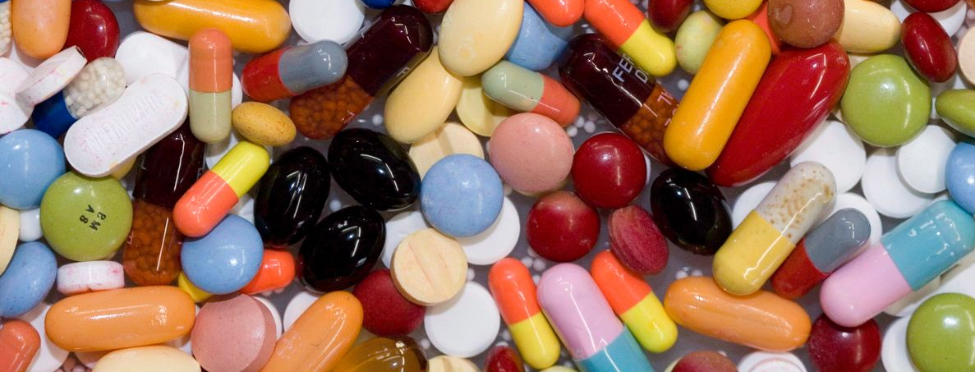
Analgesics+ :
Part 3 - Opioids
Ken Wojcikowski, PhD (Pharmacology and Toxicology; School of Medicine, University of Queensland)

Slide 65
Specific objectives for Part 3
Define the terms ‘narcotic’ and ‘opioid’.
For each of the following opioids, name the most significant contraindications and side effects, the approximate duration of action and the approximate strength relative to each other.
  *Oxycodone*
  *Tramadol*
  *Codeine*
  *Morphine*
  Methadone
  Naloxone (an antagonist)

Slide 66
Introducing and understanding opioids in general
Dr Ken Wojcikowski

Slide 67
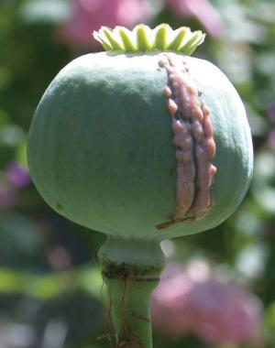

Papaver somniferum
Shutterstock images
Notes:
67

Slide 68
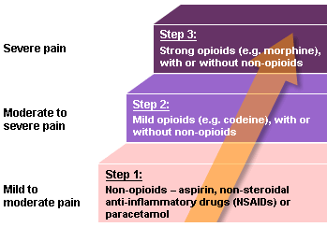
Analgesic Ladder
Notes:
68

Slide 69
Opioids
Severe pain: trauma, post op, cancer and severe non cancer related pain
  Do not abolish pain
Chronic pain:
  If other analgesics unsuitable/inadequate
Cough suppressant
Diarrhoea
Prior to anaesthesia

Slide 70
Opioids
Not all types of pain respond
Risks:
  Tolerance. Mu receptor effect
  Dependence
  Addiction
  Loss of autonomy
  Safe keeping of drugs and medications

Slide 71
Understanding the actions and side effects of opioids
Dr Ken Wojcikowski

Slide 72
Adverse effects of opioids
Nausea and vomiting
Constipation (no tolerance)
Respiratory depression
Itch
Pupil constriction
Drowsiness/sedation
Urinary retention
Dependence/tolerance
Hypotension (histamine)

Slide 73
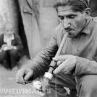
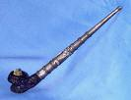
Routes of administration
Oral
Transdermal
S/c, IV, IM
CSCI
PCA
Nebulised
Epidural
Shutterstock images
Notes:
73

Slide 74
Opioid Pharmacology
Prevents transmission of pain impulse by acting pre/post synaptically in CNS
Mimics endogenous opioids.
Four opiate receptors in CNS:
  MU: analgesia, respiratory depression
  Kappa: analgesia, sedation
  Delta: hallucinations
  Epsilon: psychosis, dysphoria

Slide 75
"Foundations of Anesthesia", second edition, 2006 Elsevier Mosby

Slide 76
The pain pathway consists of three ‘orders of neurons’
Depicted here as:
Primary
Secondary
Tertiary

Slide 77
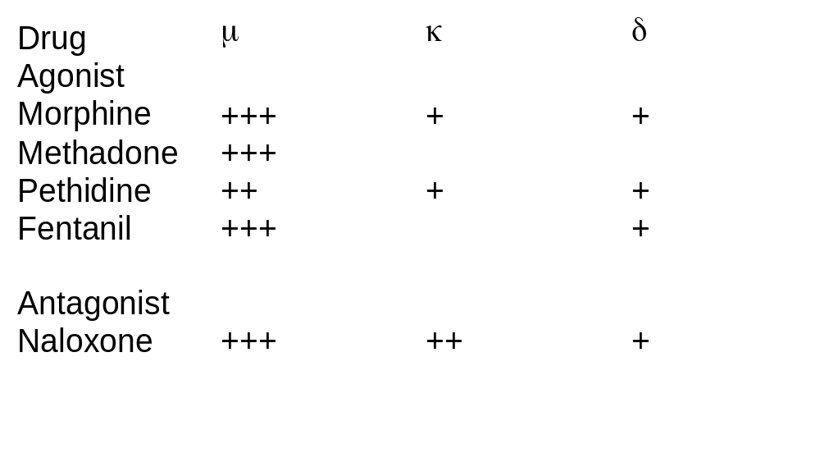
Opioid Pharmacology
Notes:
77

Slide 78
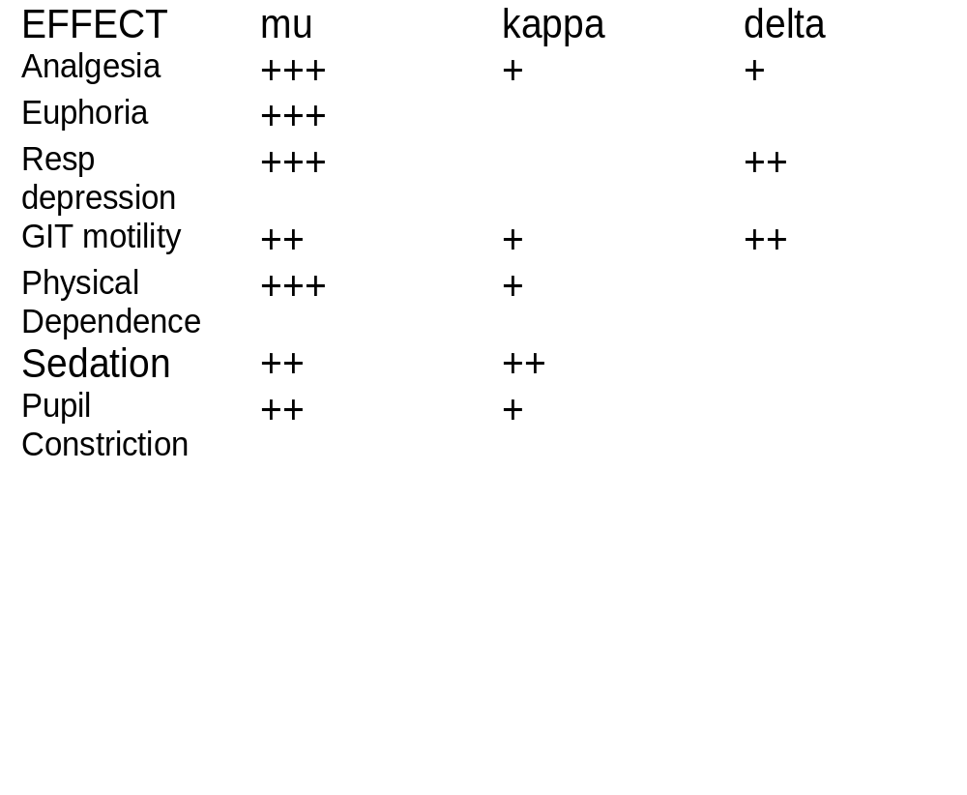
Opiate Pharmacodynamics
Notes:
78

Slide 79
Specific opioids
Dr Ken Wojcikowski

Slide 80
Morphine
Moderate to severe acute/chronic pain
Metabolised to glucuronide. M6G. Long half life
Once 24 hour dose of morphine established, introduce a slow release preparation
Rescue dose: one 6th of total daily dose
Schedule 8 drug…..

Slide 81
Dosing of Morphine
Titrate dose to response
Acute pain: 7.5-12.5mg sc/im every 2 hours prn
Children: weight. 20-40mcg/kg
30mg oral morphine equivalent to 10mg sc/im/iv
Monitor closely

Slide 82
Opioids for chronic pain
Many types of chronic pain do not respond to opioids.
Start: low dose modified release morphine e.g. 5-20mg bd
Titrate slowly
Avoid injectable opioids
Patches:
  Unsuitable for acute/fluctuating pain
Codeine :
  Short acting
  Mild/moderate pain

Slide 83
Concerns with Morphine
Addiction unlikely if used to manage pain…Traditional beliefs
Tolerance
Toxicity:
  Patients with renal impairment
  Dose increased too rapidly
  Overlap between therapeutic & toxic concentrations
  Monitor regularly for respiratory depression
Notes:
83

Slide 84
Oxycodone
Oxycodone….greater bioavailability 60-90%
1.5-2 times as potent
Mu and Kappa agonist
Available as CR and quick release tabs
Similar tolerability and efficacy
Hillbilly heroin…chewed oxycontin

Slide 85
Opioid Induced bowel dysfunction
Symptoms:
  Abdominal pain, bloating, reflux, dry, hard stools
7 out of 8 patients require laxatives
Opioid receptors throughout entire gut
  Decreased peristalsis
  Decreased secretion of intestinal fluids
  Increased sphincter tone
  Enhanced fluid absorption
  Tolerance does not occur
Notes:
85

Slide 86

Targin: Oxycodone/naloxone
Reduce opioid induced GI effects:
  Constipation, nausea.
5mg/2.5mg – 40mg/20mg.
Give twice a day.
No abuse potential.
Liver?

Slide 87
Hydromorphone
5-7 times as potent as morphine
High solubility/Small volume
Rapid onset and short duration
Toxic metabolites may accumulate in renal failure….hyperexcitability
Dose orally every four hours
Or CSCI

Slide 88
Codeine
Weak opioid….Step 2 of WHO ladder
Metabolised to morphine by CYP2D6
10% of Caucasians unable to metabolise
Can be combined with paracetamol
Constipation and drowsiness
Do you get relief from codeine?
That is a question you should ask, because 10% of clients will NOT metabolize the codeine to the active form (morphine)

Slide 89
Fentanyl
IV, patch and lozenge
100mcg equiv to 10mg morphine s/c
Patch 25mcg/hr equiv to 90mg/24hrs morphine
  Avoid in the acute setting
      Carefully Check patients for patches
Lozenge for breakthrough
  Rapid onset 5-15 minutes
    Lipid soluble
Lower incidence of constipation and confusion
Notes:
89

Slide 90
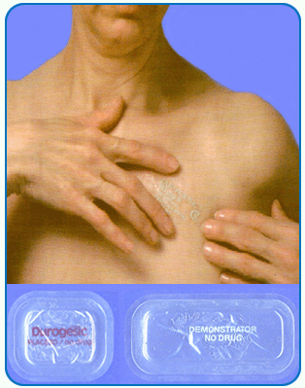
Fentanyl Patch
Dangers:
  Avoid in opioid naive patients
    Fatal respiratory depression
  Too rapid titration
    Start with lowest strength
24-72 hours to reach maximum effect
Heat increases drug release
Change every 3 days

Slide 91
Fentanyl analogues
Alfentanil, Remifentanyl & Sufentanil
  More rapid onset: 1-2 minutes
  Shorter duration of action
  Remifentanil useful in multi-organ failure
  Conscious sedation
Notes:
91

Slide 92
Use of Opioid patches
Apply to dry, cool, hairless skin
  Upper chest/outer arm
Write date/time of application
Remove old patch before applying new one
Avoid excess body heat e.g. saunas
Remind health professionals you are wearing a patch e.g. On admission to hospital
After use....fold patch on itself and dispose of carefully

Slide 93

Tramadol
MOA
    Synthetic analgesic
      weak mu agonist effect
      some inhibitory action on Noradrenaline and serotonin reuptake in the CNS.
      Potent metabolite
    Its analgesic effects thought to be independent of mu receptor; only partially antagonised by Naloxone
Notes:
93

Slide 94
Tramadol: Adverse effects
Common: Nausea, vomiting, sweating, sedation & dizziness.
More serious: Confusion, hallucinations and seizures (care in epilepsy).
Serotonin syndrome.
  Serotonin poisoning.
  Mental state changes: confused, agitated.
  Tremor, hyperreflexia.
  Shivering, sweating, fever.
Drug interactions: TCA’s, SSRI’s and warfarin.
Notes:
94

Slide 95
Methadone
VERY strong bond, means that it knocks off heroin or morphine
Useful in preventing a good portion of the withdrawal symptoms
Very long half life.
Notes:
95

Slide 96
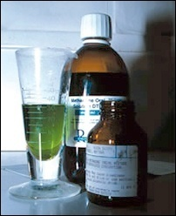
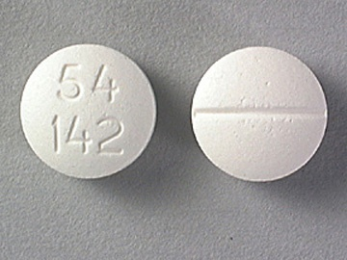
Methadone

Slide 97
Methadone
NMDA receptor antagonist
  Mu receptor agonist
Long half life; dose titration difficult
  15-100 hours
  12 days after a dose change
No toxic/active metabolites
High bio-availability
ADR’s: sedation and confusion
Drug interactions
Notes:
97

Slide 98
Methadone
Difficult to dose adjust
  Single dose: 1-2 as potent as morphine
  Long term: 10 times as potent
Used in Palliative care patients
  Given twice a day
Stigma
SSRI’s….toxicity
Notes:
98

Slide 99
Opioid Potencies
Compared to oral morphine
Codeine | 0.1 | 3-6 hours.
Tramadol | 0.2 | 4-6 hours.
Oxycodone | 1.5-2.0 | 3-4 hours.
Hydromorphone | 7.5 | 4-5 hours.
Methadone | 5-10 | 8-11 hours
Fentanyl patch | 100-150 | 72 hours.
Notes:
99

Slide 100
Analgesics+ : Part 4
Neuropathic and Chronic Pain / Anaesthesia
Introductory Pharmacology PHA00315
Ken Wojcikowski, PhD (Pharmacology and Toxicology; School of Medicine, University of Queensland)

Slide 101
Specific objectives for Part 4
Define chronic pain and neuropathic pain
Describe the medications used to treat chronic and neuropathic pain
  *Amitriptyline*
  *Gabapentin*
Name the 4 stages of anaesthesia
Briefly state the indications for Bupivacaine.

Slide 102
Understanding chronic pain and neuropathic pain
Dr Ken Wojcikowski

Slide 103
Neuropathic Pain
Drug, disease or injury induced damage or dysfunction of nervous system
Burning, cold, tingling, numbness
Common in:
  Phantom limb pain
  Spinal cord injury
  Peripheral neuropathy
  Post herpetic neuralgia
  Cancer related pain
  Diabetic neuropathy
Notes:
103

Slide 104
Management of chronic and neuropathic pain
Treat aggressively and early
Start with TCA or SNRI
Trial one drug at a time
Combination approach
Assess effectiveness
Balance efficacy, cost & adverse effects

Slide 105
Adjuvant Analgesics
Corticosteroids
Antidepressants
NMDA receptor channel blockers
Benzodiazepines: alter perception of pain
  Short term use
  Muscle relaxant
Anticonvulsants
      Sodium Valproate
      Carbamazepine
      Gabapentin
      Lamotrigine ineffective
Notes:
105

Slide 106
Tricyclic Antidepressants
E.g. *amitriptyline*, nortriptyline
Neuropathic pain…smaller doses
Drowsiness, dry mouth, constipation, impaired cardiac conduction
Postural hypotension….elderly. Less with nortriptyline
Doses above 75mg: adverse effects
Response depends on duration of pain
Opioid sparring in cancer pain
Notes:
106

Slide 107
*Carbamazepine*
Stabilise membranes/inc effectiveness of GABA
Start slow and titrate up. 50-100mg od-bd
Nausea, dizziness, rash and sedation
Take with food
Monitor liver, renal and blood counts
Enzyme inducer and increases metabolism of tramadol and methadone
First choice in trigeminal neuralgia
Notes:
107

Slide 108
*Gabapentin* & Pregabalin
Interfere with release NA, substance P & glutamate
Start low and titrate up
Renally excreted
Dizziness, somnolence and ataxia
Neuropathic pain 900-3600mg/day
No drug interactions
Short half life
PBS
Notes:
108

Slide 109
*Gabapentin*/Pregabalin
Gabapentin: Useful in post herpetic neuralgia & diabetic neuropathy
Pregabalin:
  Limited data
  Anticonvulsant, analgesic
  Inc dose slowly. Start at 75mg
  Renally excreted unchanged
  Users..as above
  Cochrane review 2011: High level pain relief in a third of patients. Moderate benefit in 50% of patients. NNT 6.
    Frequent & tolerable side effects.
Notes:
109

Slide 110
Neuropathic pain: Practise Points
Can combine adjuvant analgesics
Non drug strategies e.g. physiotherapy, sleep hygiene
Topical capsaicin 0.75%
Avoid:
  Two different antidepressants
  An antidepressant with tramadol…serotonin toxicity

Slide 111
Marijuana and neuropathic pain
Marijuana is beneficial for relief of neuropathic pain
Purified extracts of certain cannabinoids or of whole plant extracts consumed orally will be found to be most beneficial
Teas will be found to be least effective
  Cannabinoids are oil based substances and very little will be available in tea
Smoking will be found to have health risks such as lung problems and sudden ‘peaks’
Standardised doses needed for safety
Contraindicated in persons under 21 years of age
Check local laws regarding legality

Slide 112
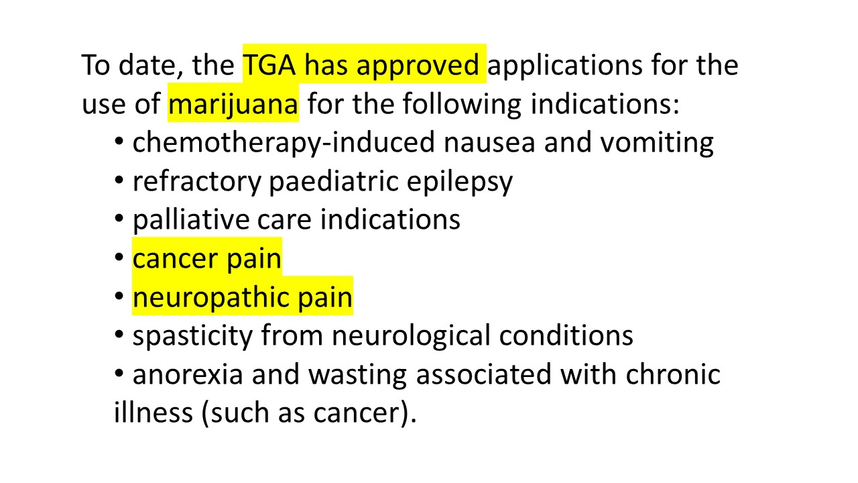

Slide 113
A word about anaesthesia
Dr Ken Wojcikowski

Slide 114
Anaesthetics
Pharmacology
  Prevents repolarisation/block electrical impulses:
    blocks Na channels
  Reversibly interrupts conduction
  High lipid solubility….more potent
  Lipophilic head/hydrophilic tail

Slide 115
History of Anaesthesia
Church “Anaesthesia is a violation of god.”
  Belief that inflicted pain strengthened faith and taught the new mother of the need of sacrifice for her children.
Church “ In sorrow, thou shalt bring forth children.”
  Patients thought anaesthesia was a divine blessing.
  Concerns re ethics of operating on a comatose patient.
Queen Victoria: 1853 and 1857.

Slide 116
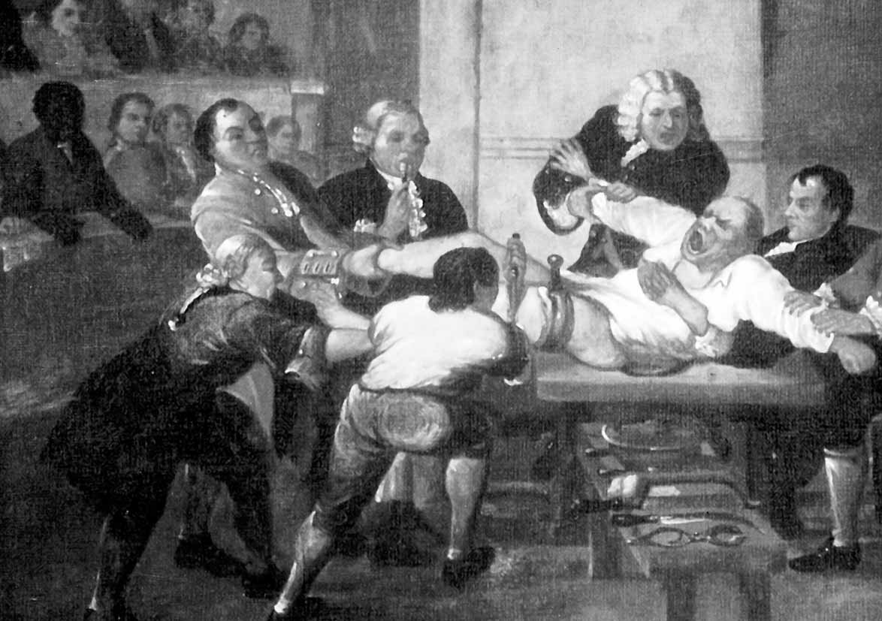
Amputation without anaesthesia
Amputation, Thomas Rowlandson, 1793.

Slide 117
Opioids in the 19th Century
1800’s standard treatment for acute pain.
Morphine industrially produced in Germany 1820’s.
1855 Alexander Wood devised a syringe with a hollow needle…overuse.
Opium and alcohol based compounds unregulated and available over the counter.
1870’s….concern about morphine habit.
1890’s di-acetylated morphine to produce Heroin.
Bayer..development of aspirin.
Notes:
117

Slide 118
General anaesthetics
Act in the CNS
Activate GABA and/or glycine receptors
Suppress NMDA receptors
  Inhalation anaesthetics:
    Nitrous oxide
    Methoxyflurane, sevoflurane

Slide 119
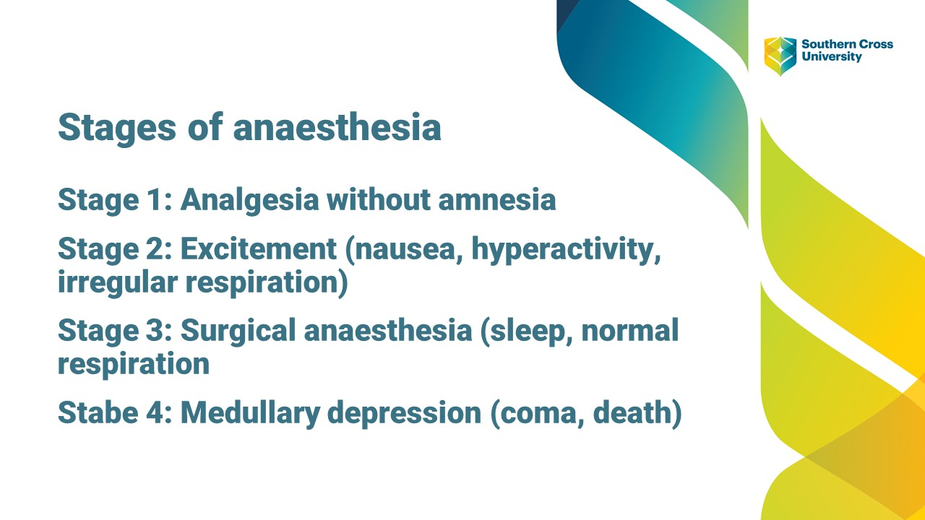
Stages of anaesthesia
Stage 1: analgesia
Stage 2:
Stage 3:
Stage 4: A

Slide 120
Local anaesthetics
Long acting: More protein bound
  Bupivicaine..3-10 hrs. PCA/epidural post op
  Potential for cardiotoxicity
  Major nerve blocks, epidurals, spinals etc
  Ropivicaine….less cardiotoxic
    Minor and major nerve blocks, epidurals and post operative pain
Short acting:
  Lignocaine…duration increased with adrenaline

Slide 121
Local anaesthetics
Add adrenaline
  Reduce/slow peripheral absorption
  Lowers peak blood concentration: less toxicity
  Intensifies local anaesthetic effect
pH adjustment
  sodium bicarbonate 8.4%: reduce stinging
  Increases rate of nerve block
  EMLA:
  Eutectic Mixture of Local Anaesthetics
Notes:
121

Slide 122
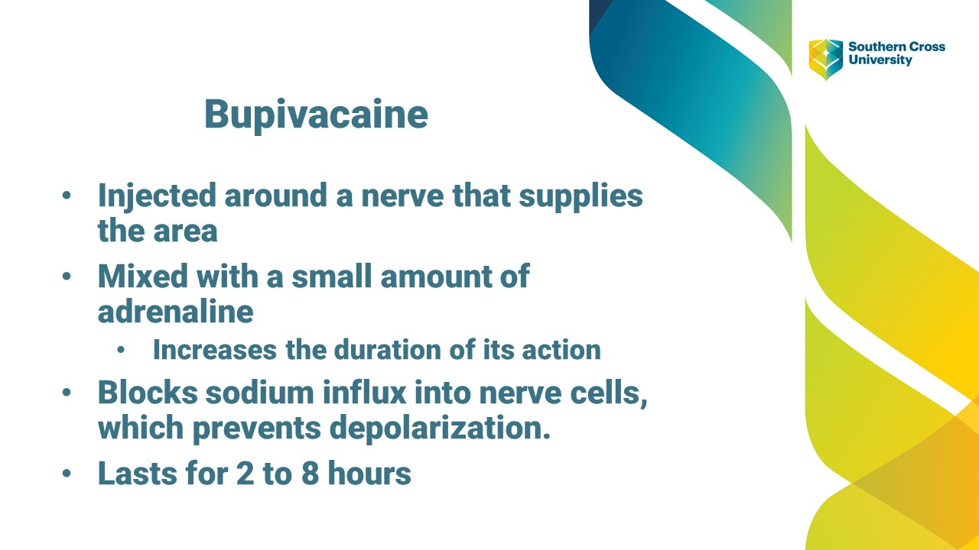

Slide 123
Useful resources
AMH (only one subscription in library)
AusDI (unlimited students can enter)
Therapeutic Guidelines Analgesia
www.australianprescriber.com.au
Ward Pharmacist

Slide 124
References (pictures for entire topic)
“Small box jellyfish (Chironex fleckeri, possibly yamaguchii)" by gautsch. is licensed under CC BY-SA 2.0
Human Anatomy and Physiology, Sixth Edition, Elaine N. Marieb. 2004: Pearson Education Inc. publishing as Benjamin Cummings.
Mayo foundation for medical education and research, 2015
Anatomy and physiology. Thibodeau GA, Patton KT. 2003 Mosby.
"Foundations of Anesthesia", second edition, 2006 Elsevier Mosby
Soil in Aspirin Bottle - H.W. Goldby, Chemist, Bentleigh, Contains Soil Sample, circa 1914-1930 Jessica Christie Source: Museums Victoria Copyright Museums Victoria / CC BY (Licensed as Attribution 4.0 International)
Amputation, Thomas Rowlandson, 1793.
Shutterstock images.

